Slide 1
4.5.2 Wordpress
Another website hosting platform

Slide 2

What is Wordpress?
Content management system that uses PHP and MySQL, includes features like plugins and templates
Templates are what make Wordpress popular to use (simple to implement)
Blog templates
Forums templates
Store templates
etc

Slide 3
How to Access Wordpress?
Depends on how you set it up
Wordpress w/ IIS:
Check IIS Manager for your wordpress site’s url binding
Usually you can access the site with “localhost/wordpress” or “127.0.0.1/wordpress”

Slide 4
How To Access Wordpress Admin Panel?
Typically under “localhost/wordpress/wp-admin”
You will need to supply administrative credentials
The Admin Panel allows you to view your site’s settings

Slide 5
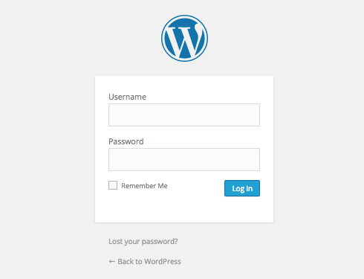

Slide 6
Admin Dashboard
what to do
update wordpress
manage users
check media
manage plugins (update, remove unnecessary ones)
manage pages, comments, a bunch of other minor stuff

Slide 7
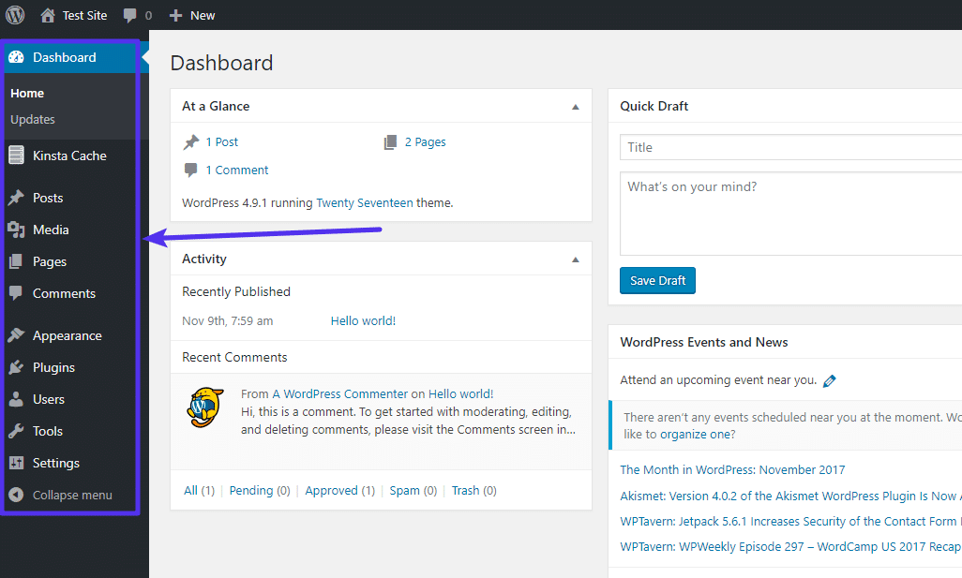

Slide 8
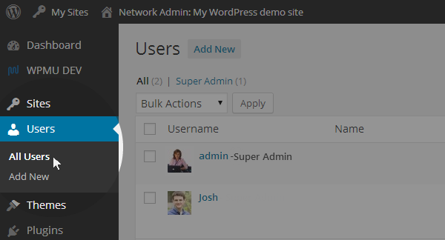

Slide 9
Change Default “admin” Username
Wordpress used to have the default Wordpress admin username be “admin.” Recent updates have changed this so you can select a custom username, but many 1-click installers still set the default username to “admin”
Three ways to do this:
Create a new admin username and delete the old one.
Use the Username Changer plugin
Update username from phpMyAdmin

Slide 10
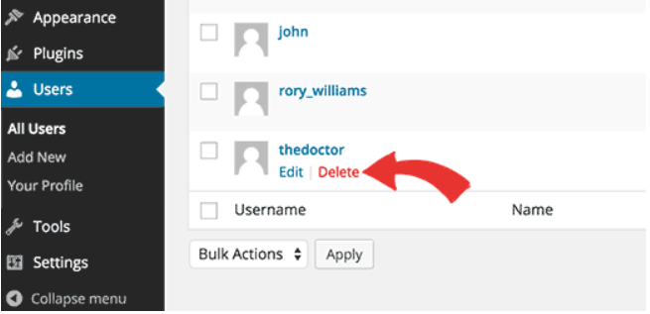
Create A New Admin Username and Delete the Old One
The easiest way is to just delete the default admin account and instead add an admin account with your desired username.
Remember to attribute all content from the default account into your new admin account when using this method

Slide 11
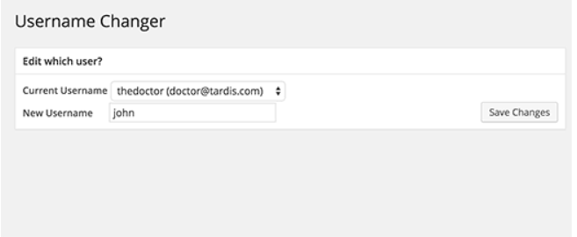
Use a Plug-in
Install the Username Changer plugin
User >> Username Changer Page

Slide 12
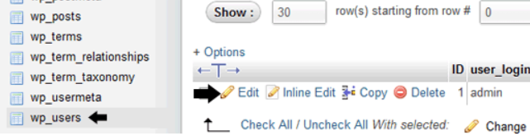
Change through phpMyAdmin
You can directly change the Wordpress database through phpMyAdmin.
To do this, select the database your website is hosted in then click on wp_users. Change the user_login value for what you want the username to be and you’re good to go.

Slide 13
Disable File Editing
This allows you to edit your theme and plugin files from the WordPress admin area. However, this can be a security risk.
This can be turned off in the wp-config.php file with the command
define( ‘DISALLOW_FILE_EDIT’, true )
if you see a similar line already in the file, change it
otherwise, just add this line in and save the file

Slide 14
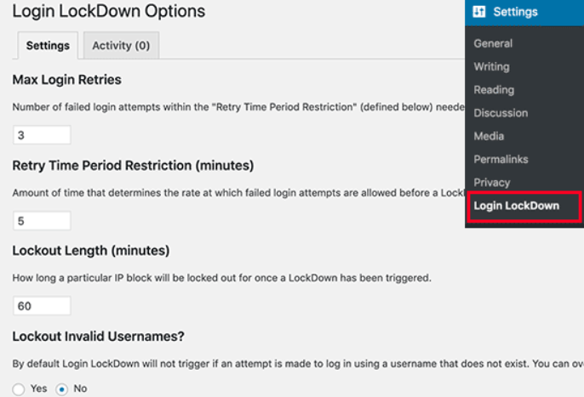
Limit Login Attempts
By default, WordPress allows users to try to login as many times as they want making it vulnerable to brute force attacks. To prevent this you can install and activate the Login LockDown plugin.

Slide 15
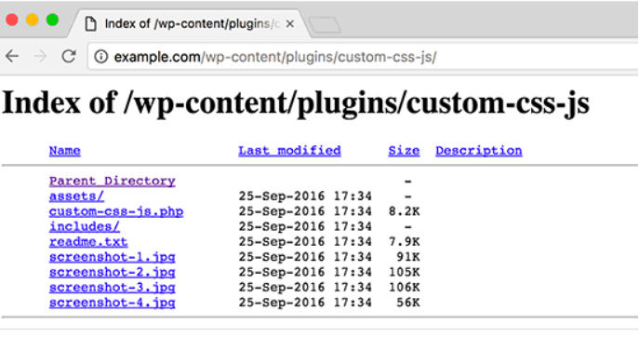
Disable Directory Indexing and Browsing
Locate the .htaccess file in your website’s root directory and add the line:
Options -Indexes

Slide 16
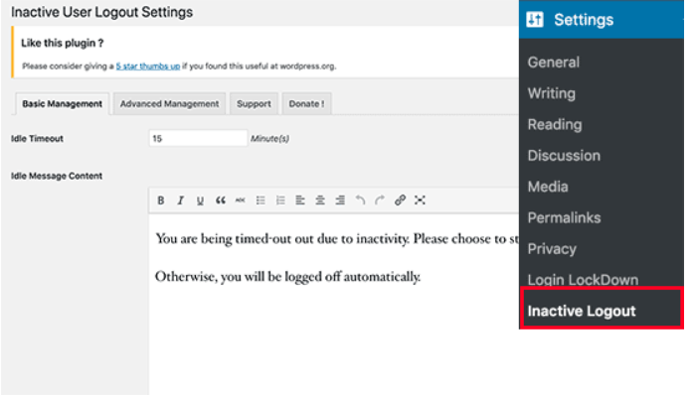
Automatically Log Out Idle Users
Sometimes logged in users can walk away from their computers for extended amounts of time posing as a security risk. To prevent this install and activate the Inactive Logout plugin.

